Slide 1
Framework and its Types

Slide 2
What is Framework..?
- A framework is a set of guidelines or rules used for creating and designing test cases
- These guidelines could include coding standards, test-data handling methods, object repositories, processes for storing test results, or information on how to access external resources.
- While these are not mandatory rules and testers can still script or record tests without following them, using an organized framework typically provides additional benefits that would otherwise be missed out on.

Slide 3
Why Framework..?
- A framework defines the organization’s way of doing things – a ‘Single Standard’.
- Following this standard would result in the project team achieving

Slide 4
What is Selenium Framework?
Selenium framework’s code structure helps you to reuse the code, reduce code maintenance, higher code readability, and allows multiple users to work on the same piece of the program.

Slide 5
Why do we need the Selenium Framework?
Easy code maintenance
Increase in code re-usage
Higher code readability
Reduced script maintenance cost
Reduced tests’ time execution
Reduced human resources
Easy reporting

Slide 6
Types of Automated Testing Frameworks
There are seven common types of Selenium automation frameworks, each with their own architecture and differing benefits and disadvantages. When building out a test plan, it’s important to choose the framework that is right for you.
Linear Automation Framework
Modular Based Testing Framework
Library Architecture Testing Framework
Data-Driven Framework
Keyword-Driven Framework
Hybrid Testing Framework
Behavior Driven Development Testing Framework

Slide 7
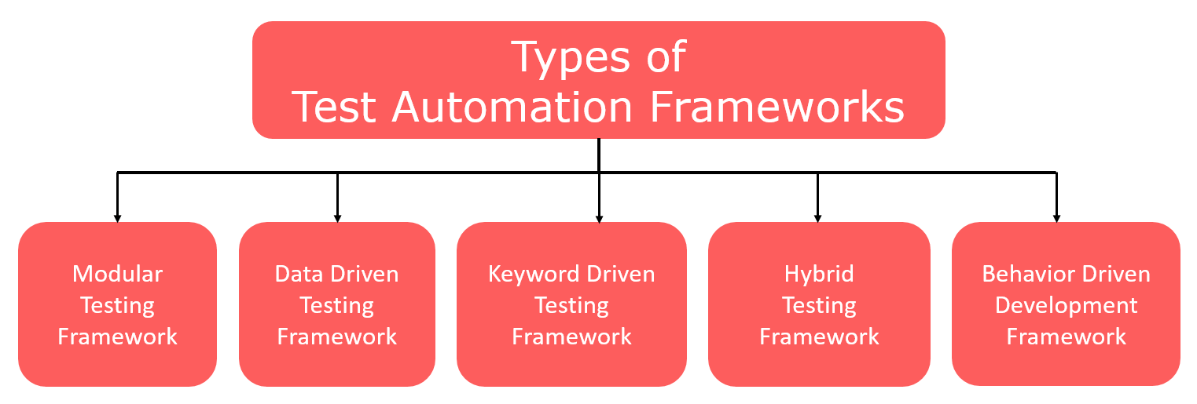

Slide 8
Linear Automation Framework
Linear Scripting Framework is a basic level test automation framework that is in the form of ‘Record and Playback’ in a linear fashion.
This framework is also known as the ‘Record and Playback’ framework.
This type of framework is used to test small-sized applications.
In this type, the creation, and execution of test scripts are done individually for each test case individually.
Testers capture each test step such as browsing, navigation, user inputs, enforcing checkpoints. Testers then play the scripts to carry out the tests.

Slide 9
Advantages of Linear Scripting Automation Framework
Can generate test scripts (Record and playback) without planning much or consume much time
Coding knowledge is not required
A quick way to generate test scripts

Slide 10
Disadvantages of Linear Scripting Automation Framework
Lack of reusability due to autogenerated scripts
Hard coding the data doesn’t allow us to run with multiple data sets
Maintenance is high – It requires a lot of effort to do even small changes.

Slide 11
Modular Testing Framework
In the modular testing framework, testers create test scripts module wise by breaking down the complete application under test into smaller, independent tests.
In simple words, testers divide the application into multiple modules and create test scripts individually. These individual test scripts can be combined to make larger test scripts by using a master script to achieve the required scenarios. This master script is used to invoke the individual modules to run end to end test scenarios.
The main reason for using this framework is to build an abstraction layer to safeguard the master module from any changes made in individual tests.
In this framework, testers write function libraries to use it whenever required. This is AKA modularity framework or module-based framework.

Slide 12
Advantages of Modular Testing Framework
Better scalability and easier to maintain due to breaking down the complete application into different modules
Can write test scripts independently
Changes in one module bring no or low impact on the other modules

Slide 13
Disadvantages of Modular Testing Framework
Takes more time to analyze the test cases and to identify reusable flows
Due to hardcoded data in the test scripts, it’s not possible to use multiple data sets.
Requires coding skills to set up the framework

Slide 14
Library Architecture Testing Framework
Library Architecture Testing framework aka “Structured Scripting” or “Functional Decomposition”
It is based on the modular framework with some additional advantages.
In the modular testing framework, we divide the application under test into modules whereas here we identify the common tasks and grouped them into functions. Once the functions are grouped then these groups will be kept in a library. The test scripts reuse these libraries to create new test cases.

Slide 15
Advantages of a Library Architecture Testing Framework
Script maintenance is simple
Easy to scalable
Function's library is reusable, and it can be reusable

Slide 16
Disadvantages of a Library Architecture Testing Framework
Coding skills are required
It takes more time to prepare test scripts
A fixed set of test data is hardcoded within the scripts

Slide 17
Data-driven Framework
The data-driven test automation framework is focused on separating the test scripts logic and the test data from each other.
It allows us to create test automation scripts by passing different sets of test data.
The test data set is kept in the external files or resources such as MS Excel Sheets, MS Access Tables, SQL Database, XML files, etc.,

Slide 18
Advantages of a Data-Driven Framework
It supports multiple data sets
Modifying the test scripts won’t affect the test data
No need to hardcode test data
Saves time by executing more tests

Slide 19
Disadvantages of a Data-Driven Framework
Require coding skills
Setting up the framework and test data takes more time
Need experienced automation testers to design framework

Slide 20
Keyword Driven Testing Framework
It is also known as table-driven testing or action word based testing.
In Keyword-driven testing, we use a table format to define keywords or action words for each function or method that we would execute.
It performs automation test scripts based on the keywords specified in the excel sheet.
The logic to read keywords and call the required action mentioned in the external excel sheet is placed in the main class. Keyword-driven testing is similar to data-driven testing

Slide 21
Advantages of Keyword-Driven Frameworks
No need to be an expert to write test scripts
It is possible to reuse the code. We can point the different scripts to the same keyword
Even though application changes, test scripts don’t change.
Tests can be designed before developing the application
Test scripts work independently of an application under test with basic modifications
Not dependent on test tools

Slide 22
Disadvantages of Keyword-Driven Frameworks
Take more time to design
The initial cost is high
Employees with good test automation skills needed

Slide 23
Hybrid Driven Testing Framework
Hybrid Test automation framework is the combination of two or more frameworks mentioned above. It attempts to leverage the strengths and benefits of other frameworks for the particular test environment it manages. Most of the teams are building this hybrid driven framework in the current market

Slide 24
Behavior Driven Development Testing Framework
The purpose of this Behavior Driven Development framework is to create a platform that allows everyone (such as Business Analysts, Developers, Testers, etc,) to participate actively. It requires increased collaboration between Development and Test Teams. It doesn’t require the users to be acquainted with a programming language. We use non-technical, natural language to create test specifications. Some of the tools available in the market for Behavior Driven Development is JBehave, Cucumber, etc.,

Slide 25
Conclusion
Even though we have seen different types of test automation frameworks. Popular test automation frameworks out of all are Data driven framework, Keyword driven framework, and Hybrid framework.
In the Data-Driven Framework, we keep test data in excel sheets & use TestNG’s data provider to execute test cases.
In Keyword driven framework, we define keywords in the excel sheet and the code will call this file to execute the test cases
The hybrid framework is a combination of both Data-driven and Keyword driven frameworks.

Slide 26
References
https://smartbear.com/learn/automated-testing/test-automation-frameworks/
https://www.softwaretestingmaterial.com/types-test-automation-frameworks/

